Slide 1
Interactive sales dashboard-task 4 summary
Internship at elevate labs
Tanzima shaikh/16 may 2025

Slide 2
Objective & dataset overview
Objective: Create an interactive dashboard using Tableau for business stakeholders.
Tools Used: Tableau, Kaggle Dataset
Dataset: Sales Data Sample from Kaggle(Includes Order Date, Product Line, Sales, Quantity, Country, etc.)
Focus Areas: Sales performance, Profit insights, Quantity sold

Slide 3
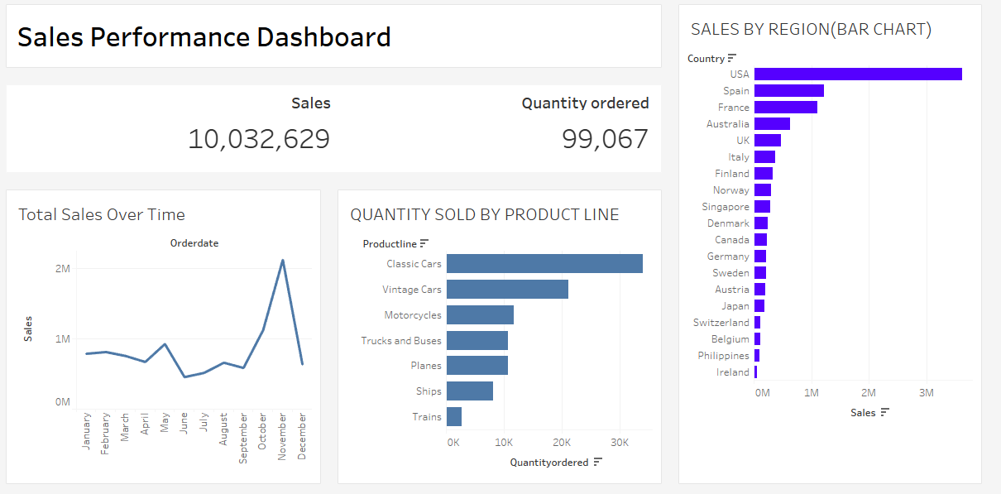
Final interactive dashboard
Built using KPI cards, slicers, and containers for clean layout.

